Slide 1
Performance evaluation
- Oversampling, costs
(Assgt 2-3 related)

Slide 2
Q. How to determine "best" model?
a. Overall accuracy does not give an accurate picture – why?
Consider: with 50/50 balanced trg data.
pred 0 pred 1
actual0 400 100
actual1 200 300 Overall Acc = 0.7
In the above, we assume a cutoff of 0.5 – is this valid?
[rationale is that since data has 50/50 split between the two classes, a cutoff in the mid-point is appropriate.]

Slide 3
If actual data has 90/10 proportion of 0s to 1s, then the above can be adjusted - How?
We can re-weight the actual cases to reflect 90/10 split in the data.
For (0,0) cell: With 50% 0s, value is 400
With 90% 0s, value = (400/0.5)*0.9 = 720
We get:
pred 0 pred 1
actual 0 720 180 Total 0s:900
actual 1 40 60 Total 1s:100
Overall Acc = 0.78.
(Accuracy of 0s and Acc of 1s stays the same, but overall acc changes)
100*(0.9/0.5)=180
With 50% 1s in data: 200
With 10% 1s in data:
200*(.1/.5) = 40

Slide 4
BUT DOES THIS MAKE A DIFFERENCE FOR YOUR PROBLEM? WHAT DO WE CARE ABOUT?
profit!!
Raw $ values:
-0.68 (cost of a mailing) and
12.32 (avg contribution – cost of mailing).
What profit values to use?

Slide 5
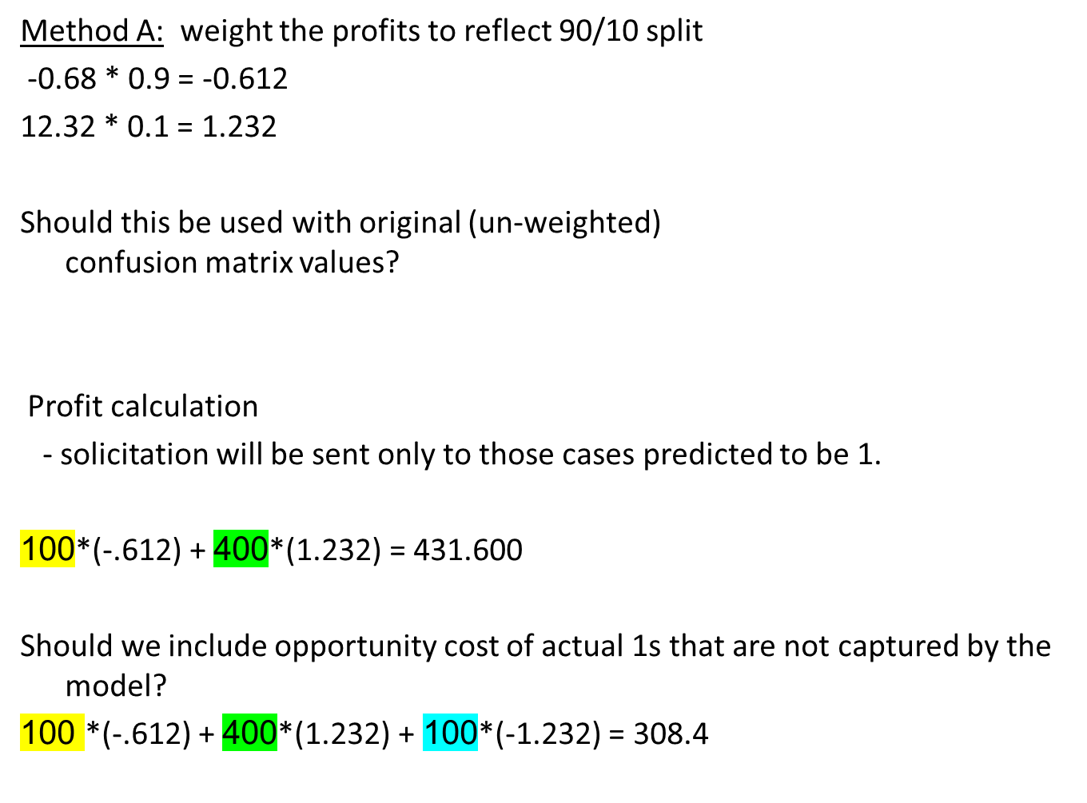
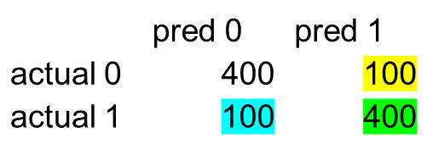

Slide 6
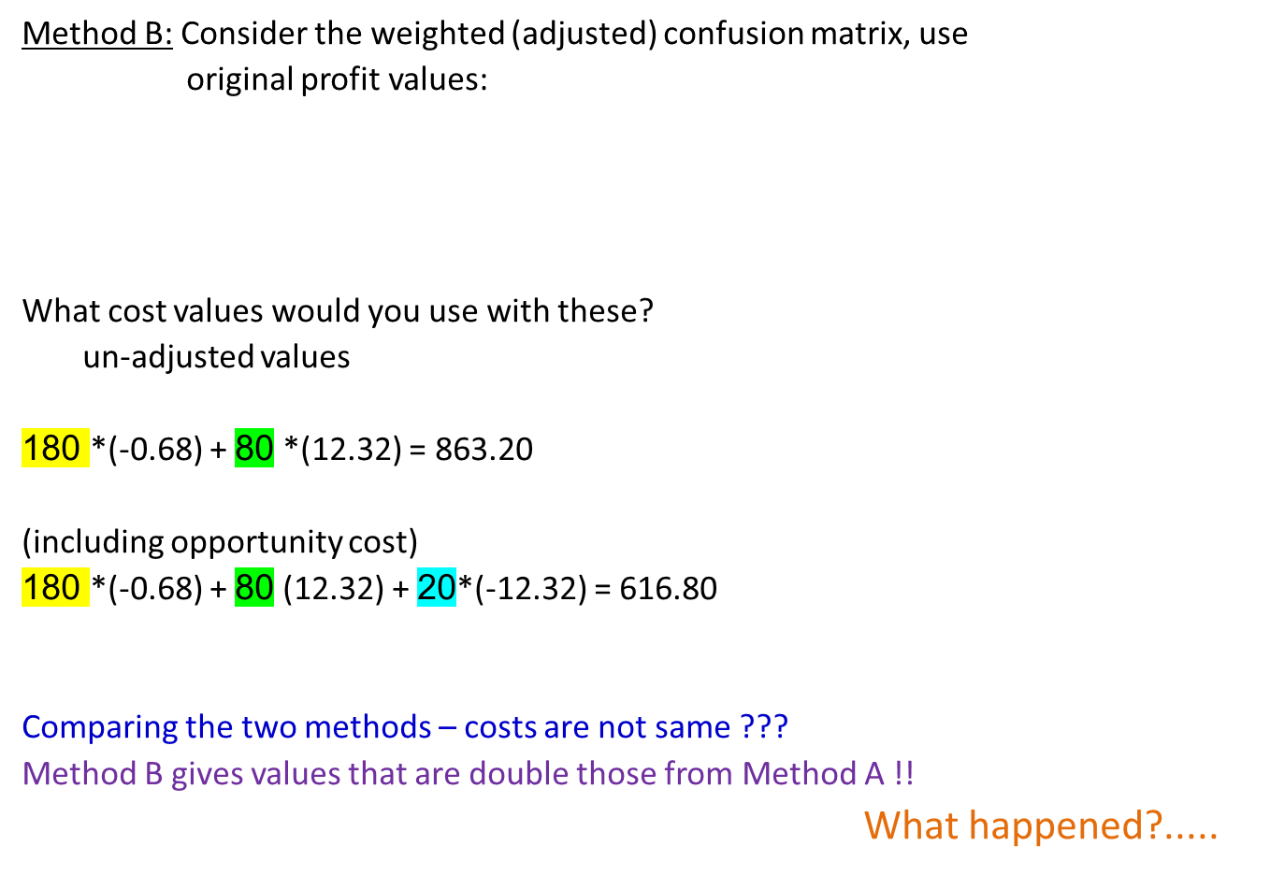
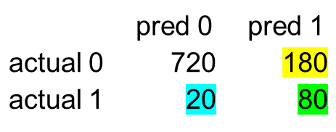

Slide 7
How were confusion matrix values weighted?
Consider actual 1s predicted as 0s -
Original value with 50/50 split in data: 100
Adjusted value considering 90/10 split in data: (100 / 0.5) * 0.1 = 20
Actual 1s predicted as 1s –
Original value with 50/50 split in data: 400
Adjusted value considering 90/10 split in data: (400 / 0.5) * 0.1 = 80
Actual 0s predicted as 1s –
Original value with 50/50 split in data: 100
Adjusted value considering 90/10 split in data: (100 / 0.5) * 0.9 = 180
Actual 0s predicted as 0s –
Original value with 50/50 split in data: 400
Adjusted value considering 90/10 split in data: (400 / 0.5) * 0.9 = 720
How were the profits values adjusted in Method A?
-$0.68 * 0.9 = -$0.612
$12.32 * 0.1 = $1.232
Different ways of weighting were used – thus the diff in costs.

Slide 8

Alternate way to weight costs –
On actual data with 90/10 split, cost for a actual 0 is: - $0.68
With 50% 0s in data, we need to consider higher cost per 0-case
With 50/50 split in data, cost for a actual 0 is: (-0.68)*(.9/.5) = -$1.224
On actual data with 90/10 split, profit for a actual 1 is: $12.32
With 50% 1s in data, we need to consider lower profit per 1-case
With 50/50 split in data, profit for a actual 1 is: (12.32)*(.1/.5) = $2.464
Then, profit from model (using unadjusted confusion matrix):
Profit = 100*(-1.224) + 400*(2.464) = 863.200
With opportunity costs
Profit = 100*(-1.224) + 400*(2.464) - 100*(2.464) = 616.80
(same as method B)

Slide 9
IS THIS THE best WAY to SELECT THE ‘BEST’ MODEL?
How will the model be used?
New data will be scored using the ‘best’ model, and cases above a cutoff threshold will be targeted.
In our analysis above, we assumed cutoff =0.5.
So, should we try to use thresholds in considering ‘best’ model?
- How?
(Threshold related to confusion matrix ??)
(Threshold corresponding to max profit?)
…….

Slide 10
Q. Consider maximum net profit
- rank cases on prob(success) (i.e. likelihood of being 1)
- calculate profits based on whether the cases are actually 0 or 1
- calculate cumulative profit
- choose maximum profit point,
and related threshold
Would you base your decision on max profit for training data or
max profit for validation data?
What profit values would you use - raw values or adjusted values ?

Slide 11
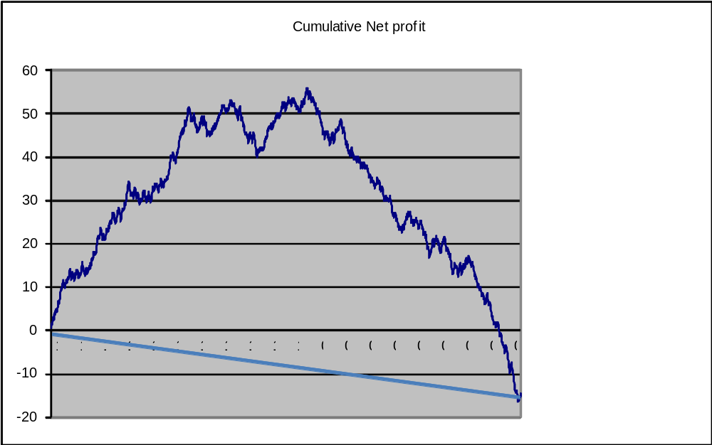
Q. Draw profit lift curves
What is lift?
How much better is the model than a naïve model (i.e. no model)
For response model:
Lift for depth d =
(Cumulative response rate at depth d) / (Avg response in full data)
For profit: average profit in full data can be negative!
Plotting the cumulative profit-

